Slide 1
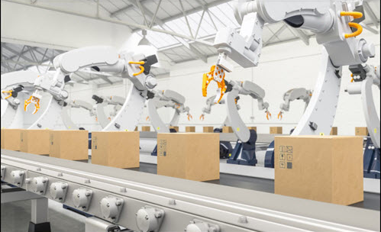
GROUP 4
Efficient application of optimization algorithms for balancing human robot collaborative assembly lines

Slide 2

LITERATURE REVIEW of TLBO in ALB: (An overview)
Teaching learning based optimization algorithm (TLBO) is a population-based meta-heuristic algorithm, which is inspired and proposed by the influence of a teacher as well as interactions among students on the output of learners in a class. It has two phases, namely the TEACHER PHASE & LEARNER PHASE.
→ In teacher phase, learners obtain knowledge from their teacher. The teacher in this algorithm is the population member with most optimised objective value (least cycle time), which is then used to bring learners (the remaining population) up to its level.
→ Suppose that at any iteration i , (M)_i is any mean value of the marks and (T)_i is any teacher population. The teacher makes an effort to move the mean value (M)_i to its own level. In this phase, the learners update their knowledge according to the equation:

Slide 3
X_new(i) = X_old(i) + { r(i) * (T(i) - Tf * M(i) ) }
Where, X_old(i) is the ith learner’s mark before updating, X_new(i) is the mark after learning from the teacher.
Tf is a teaching factor, which controls the mean value to be changed, r(i) is the uniform random number from 0 to 1.
→ In the learners phase, learners increase their knowledge among themselves through interacting randomly with other learners. Moreover, a learner gains knowledge from the more knowledge and experience person. The process of learners phase implementation could be described as follows:
At any iteration i , for all consecutive population X_old(i), after undergoing a teachers phase iteration, a random learners’ partner population X(p) is selected and evaluated as:
X_new(i) = { X_old(i) - { r(i) * ( X(i) - Tp * X(p) ) , f(X(i)) > f(X(p))
X_old(i) + { r(i) * ( X(i) - Tp * X(p) ) , f(X(i)) < f(X(p)) }
Simultaneously, the value of X_new(i) is updated and accepted if its objective function yields a better solution than X_old(i). [1]

Slide 4
TRADITIONAL TLBO vs Modified TLBO (MTLBO) approaches :
Firstly, every recent/yet to become publications that propose different variations/modifications of the traditional TLBO expressions revolve around the idea that there are numerous ways in which both teaching and learning activities can happen in a classroom.
These numerous possibilities of adjusting the meta-heuristic environment to allow efficient solution generation, according to the specific problem environment is what equips the TLBO algorithm with total flexibility. This is also largely the fact as to why we chose to explore different combinatorial TLBO expressions for our problem.
Therefore, variations here mean trying to improve and vary every sub-process of both the teacher and learner phase expressions. Some of the most significant modified TLBO approaches used for different problem environments are exemplified as follows:
A modified TLBO algorithm named mTLBO, introduced concept of tutorial class in the Learner Phase e by utilizing a collaborative discussion among learners as well as among both learners and teacher.
Another approach named NIWTLBO, where a nonlinear inertia weighted factor was added to control the memory rate of learners (i.e., how much each and every learners population was updated in both the phases) and again a dynamic inertia weighted factor in both phases to provide faster convergence speed and higher calculation accuracy.

Slide 5
An approach named DLTLBO, where a neighborhood search of teacher phase is added to produce a new mutation vector, thereby taking the advantage of differential learning (following a similar approach of differential evolution) to generate the new mutation vector. Moreover, it also utilizes the crossover operation to generate new solutions and improve the diversity.
BTLBO, a balanced approach introduced by Rao et. al (2021)to solve real-world complex optimization problems by introducing two new so called tutoring and restarting phases with an aim of providing an appropriate balance between exploitation and exploration capabilities. The tutoring phase is added to perform a local search and speed up the convergence in order to exploit regions around the best of all solutions (to improve the quality of learners and accelerate the convergence). The restarting phase is added to explore the population and keep the diversity medium (to avoid trapping into local optima and converge accurately). Moreover, the above said restarting phase is implemented by replacing the whole population with another randomly generated population, signifying that this algorithm’s main objective is to significantly increase the possibility of finding the global optima.
The basic intention behind introduction of modifications by combining various other nature inspired meta-heuristic approaches are to:
Enhance exploration
Converge to optima in an appropriate time to improve efficiency.
Avoiding premature convergence towards local optima.
To increase the overall logical suitability of the approach, based on the optimization problem. [2]

Slide 6
HISTORIC PROBLEM SOLVING APPROACHES IN ALBPs using TLBO TILL DATE:
In the problem area of ALB, RALB and human-robot collaborative ALB, the use of TLBO, in short, is VERY LIMITED.
Every publications regarding ALB techniques carried out till date include the algorithmic advancements of all possible constraints and work conditions, allocation considerations, impact of layout and real life implications. However, even in standard and generalised assembly line considerations (involving no automation), majority of the meta-heuristic techniques employed belong to Genetic algorithm, differential evolution and a considerable amount in other related fields.
In the context of TLBO, researchers have implemented several approaches of modified & hybrid TLBO algorithms only for two-sided assembly lines (U-shaped and parallel) without the considerations of either single-side or the parallel assignment of cobots and human workers to different stations with balanced distribution of workload. [3,4,5]
Thus, we follow the same intentions to improve our problem solving approach, by trying to explore the flexibilities of TLBO with its hybrid approaches, in order to properly suit the human-robot collaborative workspace.

Slide 7
PAPERS REVIEWED FOR LITERATURE IN TLBO:
[1] Y. Ma, X. Zhang, J. Song et al., A modified teaching-learning-based optimization algorithm for solving optimization problem, Knowledge-Based Systems (2020), doi: https://doi.org/10.1016/j.knosys.2020.106599.
[2] Ahmad Taheri, Keyvan RahimiZadeh, Ravipudi Venkata Rao. An efficient Balanced Teaching-Learning-Based optimization algorithm with Individual restarting strategy for solving global optimization problems, Information Sciences, Volume 576, 2021, Pages 68-104, ISSN 0020-0255, https://doi.org/10.1016/j.ins.2021.06.064.
[3] Hamzadayi, A. (2018). Balancing of mixed-model two-sided assembly lines using teaching-learning based optimization algorithm. Pamukkale University Journal of Engineering Sciences, 24, 682-691.
[4] Li, Da & Zhang, Chaoyong & Shao, Xin & Xie, Zhan. (2014). An Improved TLBO Algorithm for Balancing Stochastic Two-Sided Assembly Line. Applied Mechanics and Materials. 610. 345-349. 10.4028/www.scientific.net/AMM.610.345.
[5] Qiuhua Tang, Zixiang Li, LiPing Zhang, and Chaoyong Zhang. 2017. Balancing stochastic two-sided assembly line with multiple constraints using hybrid teaching-learning-based optimization algorithm. Comput. Oper. Res. 82, C (June 2017), 102–113. DOI:https://doi.org/10.1016/j.cor.2017.01.015

Slide 8
How & Why is TLBO A GREAT CHOICE, for our problem?
The problem that we considered is solving multi objective human robot collaborative assembly line balancing.
TLBO being a new algorithm, is yet to be explored by many researchers and this gives novelty to our paper.
As explained in the above slides, TLBO can be modified easily according to the problem as it has very less parameters yet more combinations that influences the output.
Many new variants can be created from TLBO as the concept is simple and easy to implement.
TLBO can be merged with other popular meta-heuristics such as Differential evolution, Genetic algorithm, Particle swarm optimization, etc.., and a hybrid algorithm can be created, which uses the simplicity of TLBO with the marginal advantages of other popular algorithms.
TLBO being easy to implement and understand, we chose it to integrate it with the Artificial Bee Colony(ABC) algorithm to produce more effective results in less iterations.
SCOUT PHASE from ABC algorithm is used in our proposed TLBO which helps it from recovering from getting trapped in a local minima. The detailed explanation of it is as follows:

Slide 9
H-TLBO:
Hybrid Teaching Learning Based Optimisation

Slide 10

The H-TLBO
The proposed algorithm is similar to TLBO, but uses the scout phase of Artificial Bee Colony algorithm to escape from local minima.

Slide 11
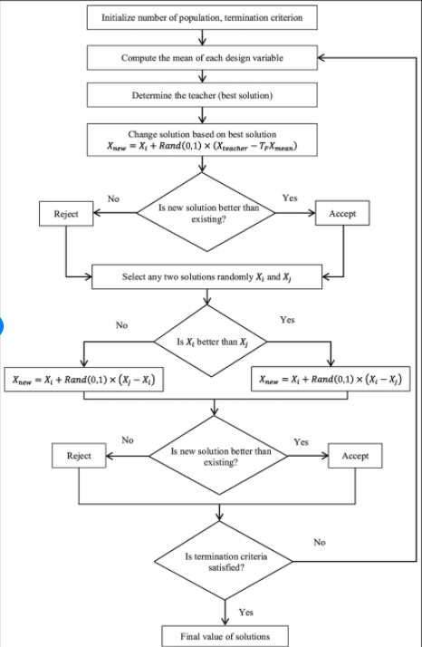
Flow diagram of traditional TLBO

Slide 12
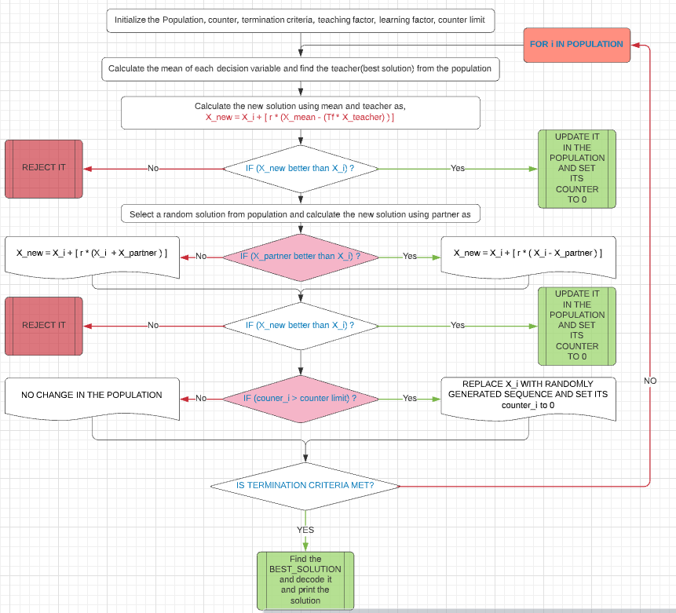
Flow diagram of proposed H-TLBO

Slide 13
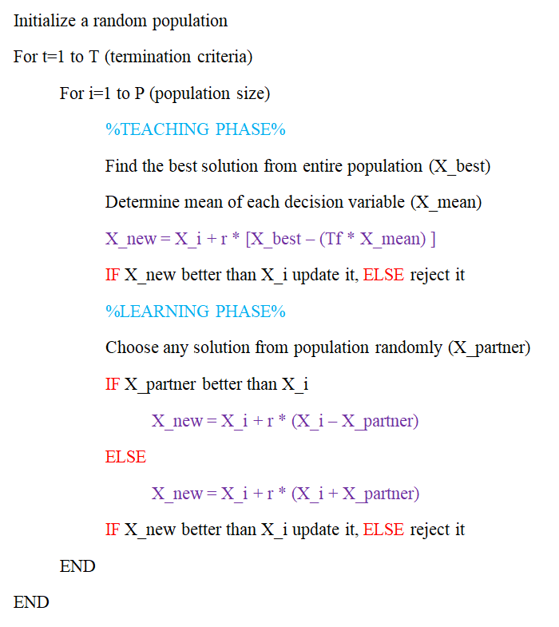
Pseudocode of Traditional TLBO

Slide 14
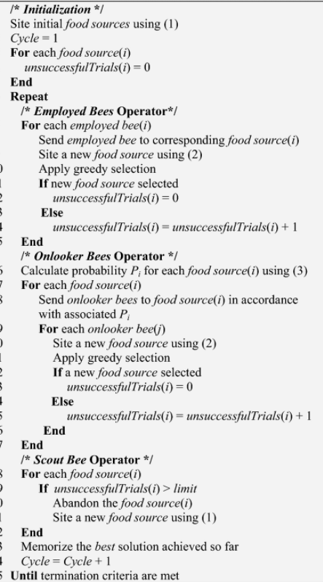
Pseudocode of Traditional ABC Algorithm

Slide 15
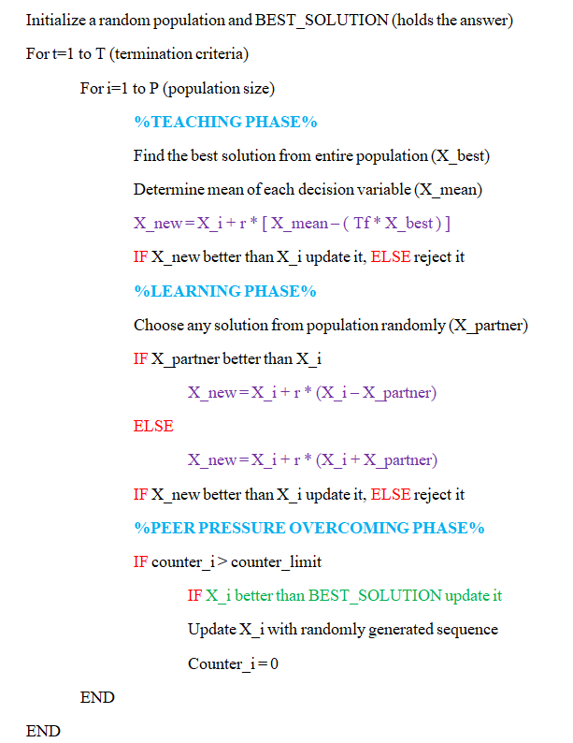
Pseudocode of proposed H-TLBO
(Merges TLBO & ABC)

Slide 16
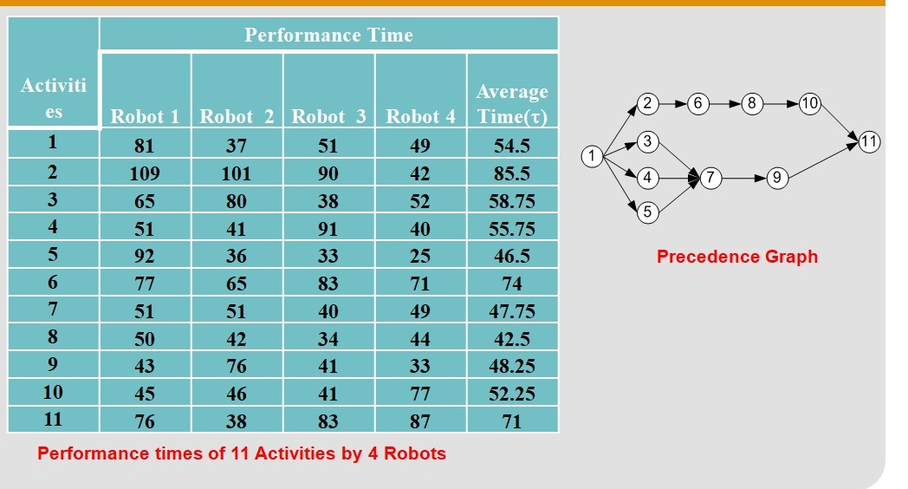
INPUT DATA USED (TASK TIME AND PRECEDENCE GRAPH)
This is the input data used that represents the task times of 4 robots for given 11 different activities that follow a certain precedence relation as shown in the network diagram.

Slide 17
INPUT DATA USED (SETUP TIME)
ACTIVITIES
R
O
B
O
T
18 | 15 | 13 | 18 | 16 | 16 | 10 | 11 | 17 | 14 | 17
10 | 11 | 16 | 16 | 14 | 16 | 10 | 18 | 14 | 13 | 20
19 | 14 | 13 | 18 | 19 | 18 | 20 | 14 | 19 | 17 | 17
11 | 13 | 13 | 15 | 11 | 12 | 11 | 13 | 19 | 12 | 14
This is the input data used that represents the setup times of 4 robots for given 11 different activities.
This setup time is added with the task time for all the robot that performs that particular task. This setup time includes the time for setting up the robot, fixing the tool, etc..,

Slide 18
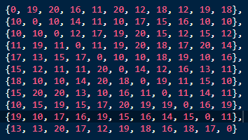
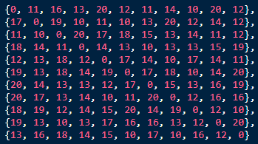
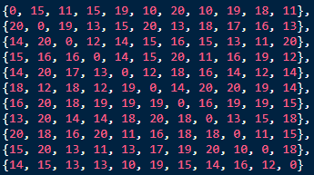
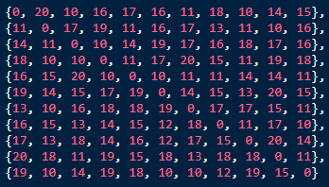
INPUT DATA USED (SEQUENCE DEPENDENT TIME)
R
O
B
O
T
1
R
O
B
O
T
2
R
O
B
O
T
3
R
O
B
O
T
4

Slide 19
FORMULATING THE ALGORITHM (MODIFIED H-TLBO)
For implementing the H-TLBO for a discrete problem, some assumptions and formulations are made such as,
Population matrix consists of feasible sequences.
A new counter array is used that stores an integer that indicates the number of times the solution is retained in the population.
A new best_solution (variable) is used to keep track of the best solution removed from the population in the last phase of the algorithm.
Updation of the population is done according to the rules that is mentioned in upcoming slides.
For encoding purpose, only the sequence array is used.
For decoding purpose, the robots assigned and the tasks performed in each station is determined by knowing the optimal cycle time.
The addition of setup times and sequence dependent time is used to make the problem more suitable for industrial purposes.
Setup time is added with the task time for each task performed by the robot.
Sequence dependent time is added only for the tasks that are not first in the station as these times are dependent on the previously performed tasks(first performed task in each station by the robot has no previous task).

Slide 20
OBJECTIVE FUNCTION CALCULATION USING CONSECUTIVE METHOD (CYCLE TIME)
For calculating the cycle time of a particular sequence generated by H-TLBO algorithm, consecutive method algorithm is used. The working of this algorithm is:
Cycle time is initially fixed with a value by summing up the minimum task time of all robots.
For each station, the sequence is tried with all the available robots with given number of stations and the cycle time that is found previously.
In each iteration, if the found cycle time is not feasible, the cycle time is incremented.
This step is repeated until a feasible cycle time is found which is the optimal cycle time for the given sequence.
The addition of sequence dependent time and setup time is also included in the cycle time to make the solution obtained more feasible and realistic for industrial usage purpose.
The sequence dependent time is added because of the precedence constraints.
Sequence dependent times is dependent on the task that is performed before the current task for a particular robot in that station.

Slide 21
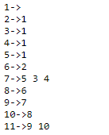
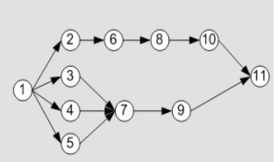
SEQUENCE GENERATION USING ADJACENCY LIST
For generating sequence, a precedence matrix is generally used in many papers.
But in our proposed method, we use adjacency list that stores the precedence relation efficiently and helps in generation of sequence that satisfied these relations.
The algorithm is as:
First a available set is created with the tasks that has no precedence tasks.
Then one task is selected randomly from that set and the tasks following it are added in the available set.
This step is repeated until all the tasks are assigned and available set is empty.
The use of adjacency list is very helpful in implementing this algorithm.
Adjacency holds the data as shown in this example.

Slide 22
WORKING OF H-TLBO
I) TEACHER PHASE
The first phase in teaching learning based optimization is the teacher phase.
In this step, a best solution from the population is selected (X_best) which is also known as the teacher.
The mean of the population is calculated (X_mean) as mentioned in upcoming slides.
Using the equation,
X_new = X_i + r * [ X_mean - (Tf * X_best) ] where,
X_i = a single i’th solution in the population
r = Coefficient that indicates the impact of the mean of the population and the teacher
Tf = Teaching coefficient that indicates the impact of teacher
X_new = newly generated solution for the ith solution in the population
X_mean = mean of the population
X_best = teacher (best solution in the population)
Once the new solution (X_new) is calculated using above formula, a greedy selection is undergone. If the X_new is better than X_i, it is updated in the population, Else it is rejected and the old is kept unchanged.

Slide 23
WORKING OF H-TLBO
II) LEARNER PHASE
The second phase in teaching learning based optimization is the learner phase.
In this step, a random solution from the population is selected (X_partner) which is also known as the partner.
This partner is selected in such a way that X_i != X_partner.
Using the equation,
X_new = X_i + r * [ X_i - X_partner ] IF X_partner is better than X_i,
X_new = X_i + r * [ X_i + X_partner ] OTHERWISE, where
X_i = a single i’th solution in the population
r = Coefficient that indicates the impact of the partner
X_new = newly generated solution for the ith solution in the population
X_partner = mean of the population
X_best = teacher (best solution in the population)
Once the new solution (X_new) is calculated using above formula, a greedy selection is undergone. If the X_new is better than X_i, it is updated in the population, Else it is rejected and the old is kept unchanged.

Slide 24
WORKING OF H-TLBO
III) PEER PRESSURE OVERCOMING PHASE
The third and last phase in teaching learning based optimization is the peer pressure overcoming phase.
In this step, for the i’th solution in the population, after it undergoes teaching and learning phase, it is checked if it was updated or not.
If the X_i gets updated, the counter_i is set to 0 and if the old value is retained, its counter_i is incremented by 1.
After doing the above steps, the counter_i is checked if it is exceeding the counter limit.
If the counter_i exceeds the counter limit, then the solution is removed from the population and is updated with a randomly generated sequence.
This phase is implemented to help H-TLBO to overcome from trapping in the local minima.
To avoid removing the global minima from the solution, a separate variable is used to keep the solutions removed like this.
This variable holds the best removed solution from the population in this phase.
While displaying the solution, the current population is compared with this variable and the best among them is printed as the solution.

Slide 25
WORKING OF H-TLBO
CALCULATING THE MEAN OF THE POPULATION
As mentioned in the previous slide, in teacher phase calculation of the mean of the population is used in the equation, X_new = X_i + r * [ X_mean - (Tf * X_best) ].
As the traditional way of calculating the mean can’t be used here (discrete optimization problem), a different methodology is utilised here.
The calculation is done as,
First the average of the task numbers in that j’th location in the population is calculated.
If the calculated average is not already present in the mean sequence, then it is pushed in to mean sequence.
If the calculated mean value is already present in the mean sequence, then closest value to the mean in that j’th location of the population is inserted if it is not present in the mean sequence.
Otherwise, a random number is generated within the range of 1 - n (number of tasks) and is inserted in the mean sequence if it is not already present in the mean sequence.

Slide 26
WORKING OF H-TLBO
SUBTRACTION OPERATOR
As mentioned in the previous slide, in teacher phase and learner phase, subtraction of the solutions is done as,
X_new = X_i + r * [ X_mean - (Tf * X_best) ].
As the traditional way of subtraction is not possible here as the variables are discrete, a different methodology is used as,
For each task number in i’th position of the sequences, if both the sequence have same task number, then 0 is inserted in the i’th position of the result.
If they are not same, a random number is generated between 0 and 1 and is compared with the coefficient(Tf / Tp).
If the random number generated is less than the coefficient then, the task number in i’th position from the second sequence is inserted into the i’th position of the result.
Otherwise, 0 is inserted in the i’th position of the result.

Slide 27
WORKING OF H-TLBO
ADDITION OPERATOR
As mentioned in the previous slide, in teacher phase and learner phase, addition of the solutions is done as,
X_new = X_i + r * [ X_mean - (Tf * X_best) ].
As the traditional way of addition is not possible here as the variables are discrete, a different methodology is used as,
For each task number in i’th position of the sequences, if both the sequence have same task number, then task number from in i’th position of first sequence is inserted in the i’th position of the result.
If they are not same, a random number is generated between 0 and 1 and is compared with the coefficient(r).
If the random number generated is less than the coefficient then, the task number in i’th from the second sequence is inserted into the i’th position of the result.
Otherwise, 0 is inserted in the i’th position of the result.

Slide 28
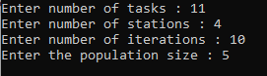
WORKING OF H-TLBO
REPAIR FUNCTION
This function is used to repair a sequence which does not follow the precedence relation. As the X_new found after performing those operations might not follow the precedence relation, this function is utilised to repair such sequences.
This does multiple swaps and replacements so that the given sequence is in bounds with the precedence relation.
GIVING INPUT TO H-TLBO

Slide 29
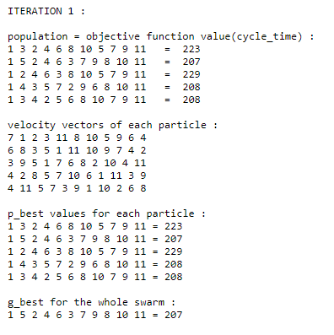
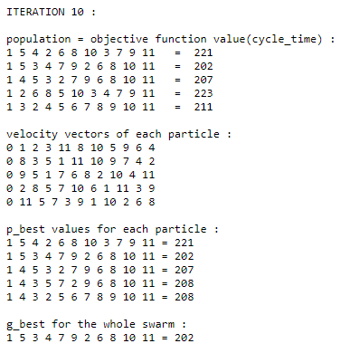
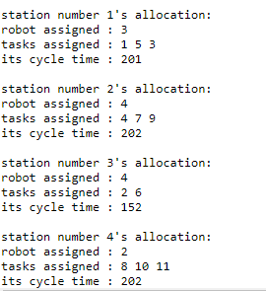
RESULT OBTAINED USING MODIFIED DPSO (previously presented algorithm)

Slide 30
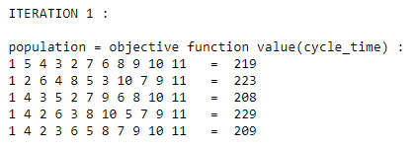
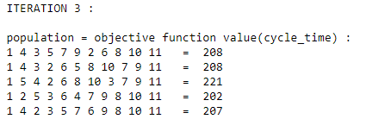
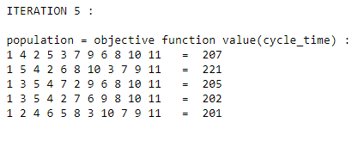
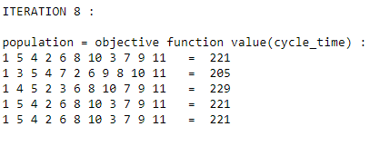
RESULT OBTAINED USING H-TLBO

Slide 31
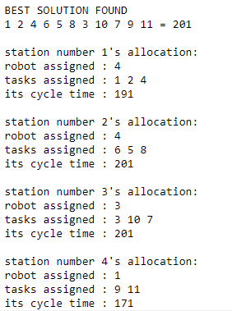
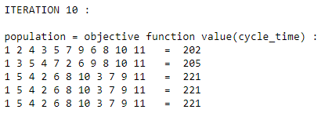
RESULT OBTAINED USING H-TLBO

Slide 32
COMPARISON OF MODIFIED DPSO AND HYBRID TLBO:
M-DPSO | H-TLBO
1.Modification of traditional Particle Swarm Optimisation to fit into solving discrete optimisation(DO) problems. 2.Number of times objective function evaluated is, Np*T (Np = population size). 3.NO GREEDY selection to update population. 4.Number of parameters that influence the output is, c1, c2, c3. 5.Number of variables in the population updation equation, Velocity, G_best, P_best. 6.Number of special operators used in equations, Addition operator, Subtraction operator, Multiplication operator, Repair function. 7.Best solution obtained is present in the population matrix. 8.Best solution obtained for the example problem, Optimal cycle time = 202. | 1.Modification of traditional TLBO which combines the advantages of scout phase from ABC algorithm and simplicity of TLBO to solve DO problems. 2.Number of times objective function evaluated is, Np*T + Np*T (T = number of iterations). 3.Uses GREEDY selection to update population. 4.Number of parameters that influence the output is, r, Tf/Tp. 5.Number of variables in the population updation equation, X_mean, X_best, X_partner. 6.Number of special operators used in equations, Addition operator, Subtraction operator, Mean calculation, Repair function. 7.Best solution obtained may or may not be present in the population matrix. 8.Best solution obtained for the example problem, Optimal cycle time = 201.

Slide 33
Did this PRESENTATION satisfy your EXPECTATIONS sir?

